Slide 1

Introduction to Microservices -Mohan Chidambaram

Slide 2
Challenges with monolithic
Difficult to scale
Long Build/Release/Test cycles
Architecture is hard to maintain and evolve
New releases takes months
Long time to add new features
Lack of Agility
Lack of innovation
Frustrated customers

Slide 3
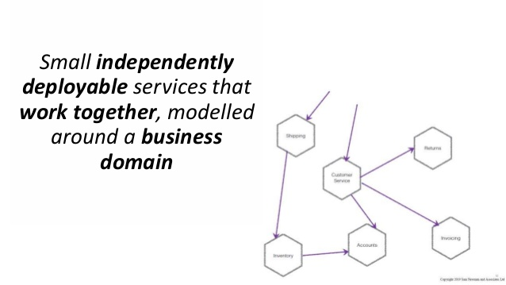

Slide 4
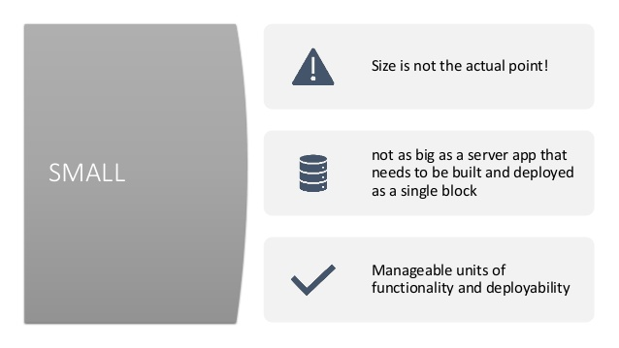

Slide 5
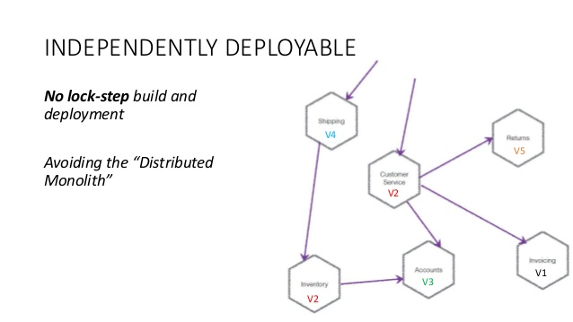

Slide 6
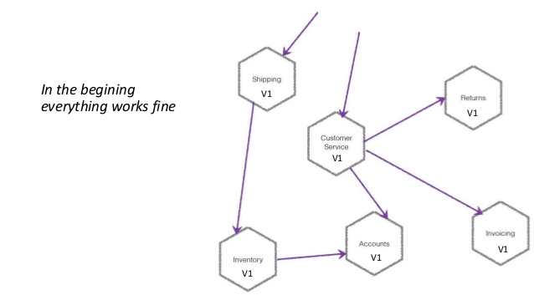

Slide 7
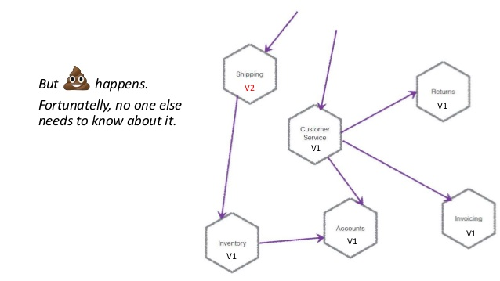

Slide 8
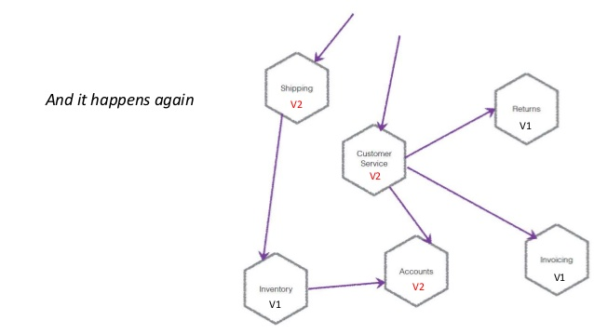

Slide 9
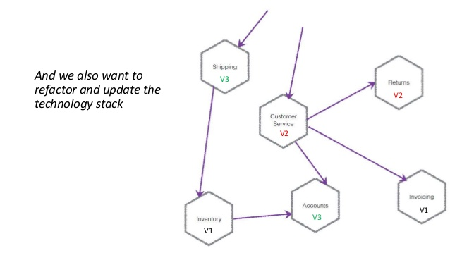

Slide 10
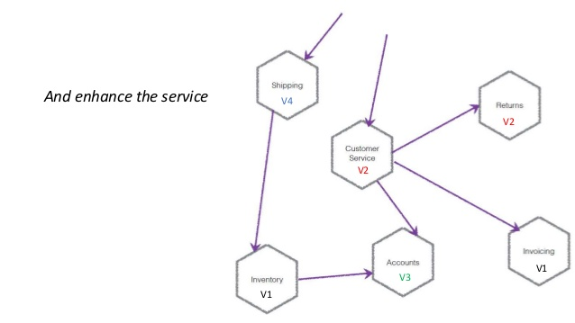

Slide 11
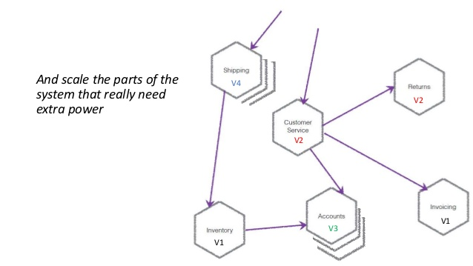

Slide 12
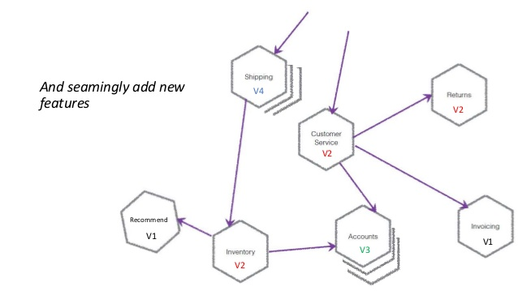

Slide 13
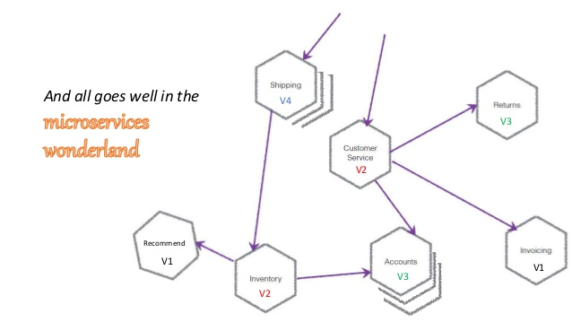

Slide 14
Benefits
Focus on one thing and do it right
Organizational Alignment
Release functionality faster
Independent scaling
Technology diversity; Adopt Technologies Faster
Enable security concern segregation
Enable resiliency by designing failiures

Slide 15
But it requires
Automation
High Cohesion
Loose coupling
Stable versioned APIs (Maturity)

Slide 16
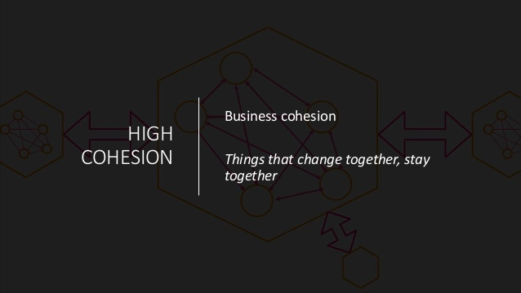

Slide 17
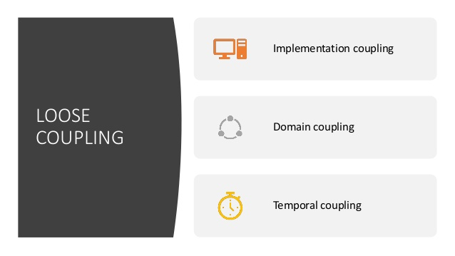

Slide 18
Downsides
Cognitive Overloading (many tooling options)
Testing is more complicated
Monitoring is more complex
Operational overhead
Resiliency isn’t free

Slide 19
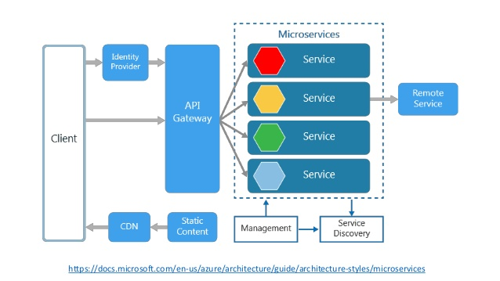

Slide 20

From Monolithic to Microservice

Slide 21
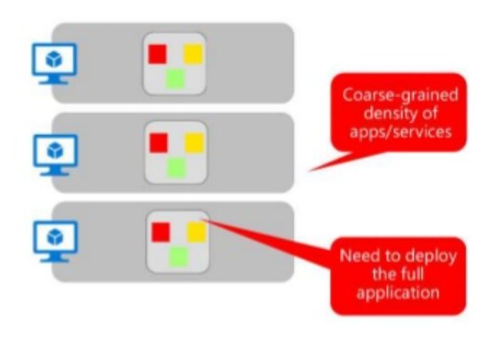
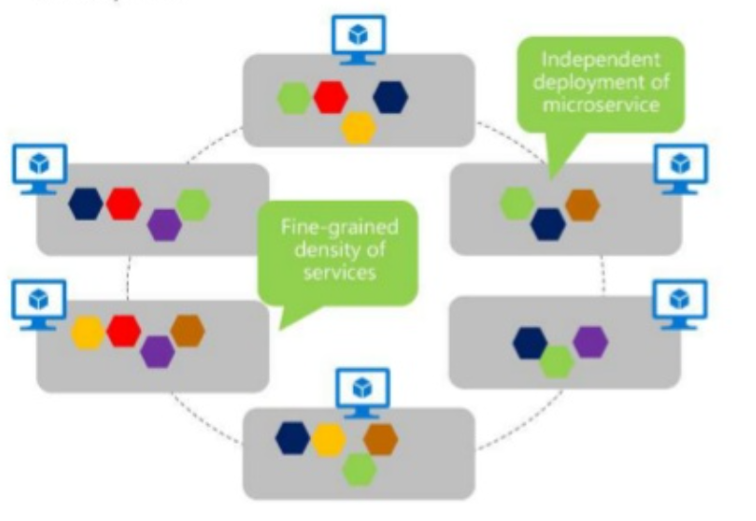
Monolithic Deployment Approach
Microservices application Approach
A traditional application has most of its functionality within a few processes that are componentized with layers and libraries
Scales by cloning the app on multiple servers/VMs
A microservice application segregates functionality into separate smaller services
Scales out by deploying each services independently with multiple instances across servers/VMs

Slide 22
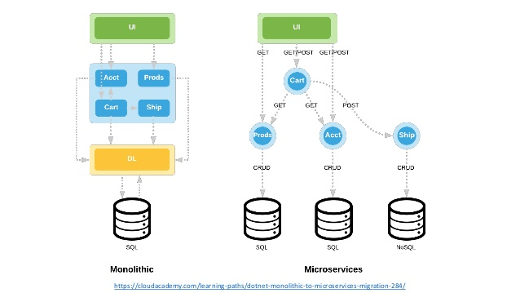

Slide 23
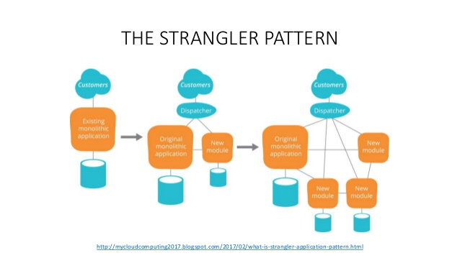

Slide 24

Principles of designing Micro service

Slide 25
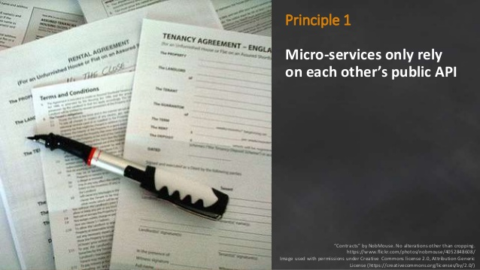

Slide 26
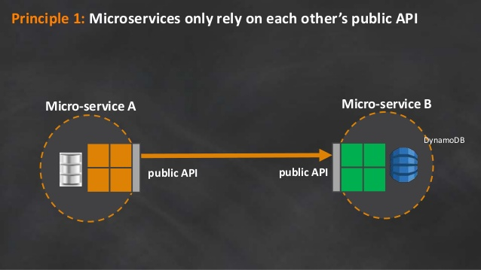

Slide 27
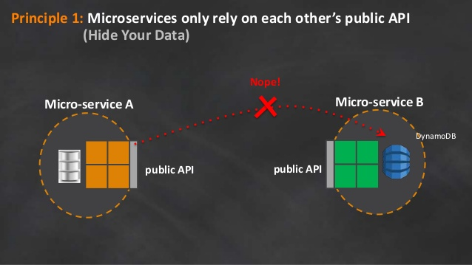

Slide 28
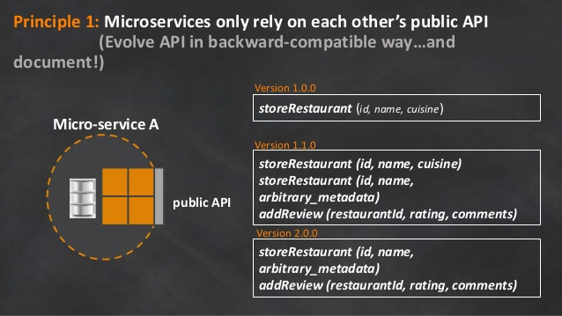

Slide 29
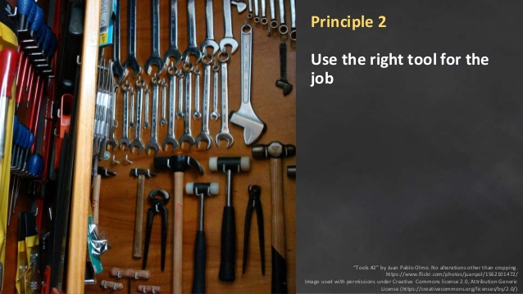

Slide 30
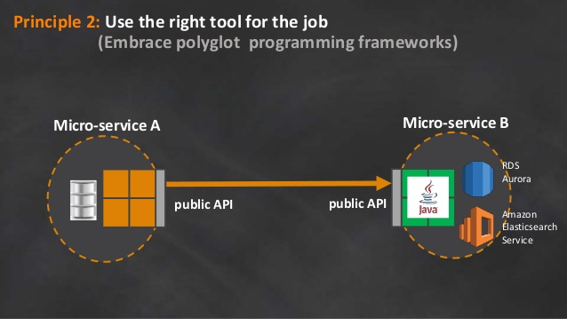

Slide 31


Slide 32
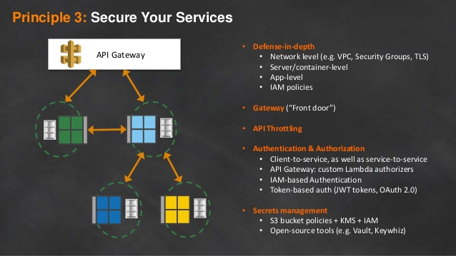

Slide 33


Slide 34
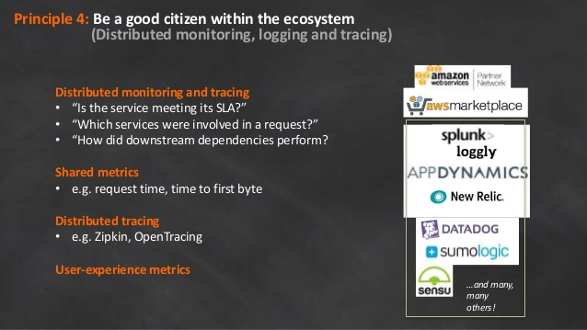

Slide 35


Slide 36
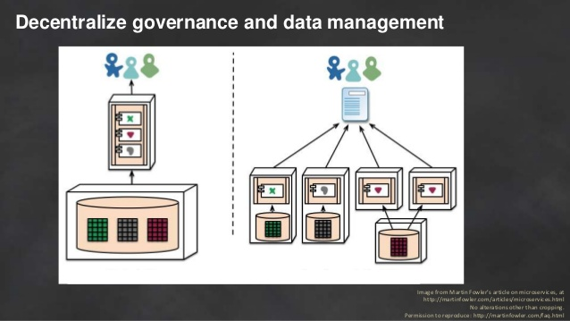

Slide 37
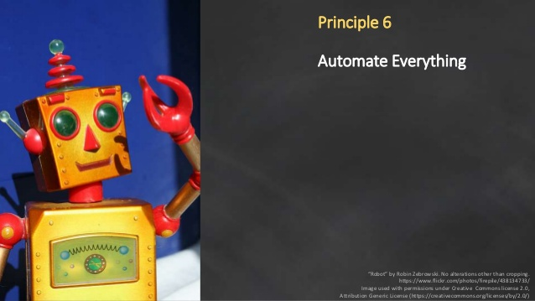

Slide 38
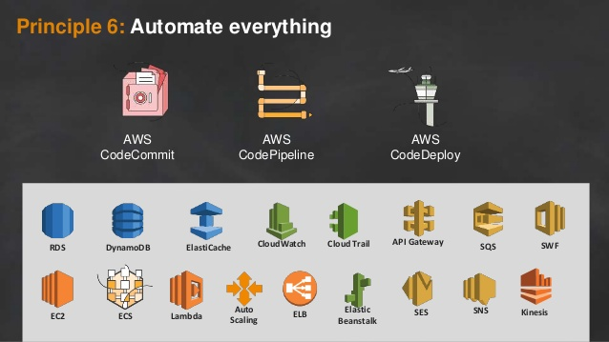

Slide 39
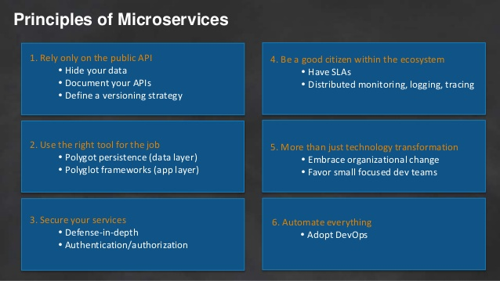

Slide 40
Benefits of Microservices
Easier to scale individual micro-service
Rapid build/test/release cycles
Easier to maintain and evolve systems
New releases takes minutes
Short time to add new features
Increased agility
Faster innovations
Delighted customers

Slide 41
Summing up.. Microservices are
Are not the goal
Are about problems at scale
Are manageable units of functionality and deployability
Own the end-to-end
Requires automation and Maturity

Slide 42
References
https://martinfowler.com/articles/microservices.html
https://martinfowler.com/articles/microservice-trade-offs.html
https://martinfowler.com/bliki/BoundedContext.html
https://docs.microsoft.com/en-us/dotnet/standard/microservices-architecture/architect-microservice-container-applications/microservices-architecture
https://docs.microsoft.com/en-us/azure/architecture/guide/architecture-styles/microservices
https://dzone.com/storage/assets/7852543-dzone-microservicesguide-2017.pdf
https://www.ibm.com/cloud/garage/architectures/microservices
https://www.infoworld.com/article/3237175/how-to-introduce-microservices-in-a-legacy-environment.html

Slide 43

Thank you..

